Slide 1
Topic 3
Divide and Conquer
Prof. Hanan Elazhary
Main source: A. Levitin, Introduction to the Design and Analysis of Algorithms, 3rd edition

Slide 2
Divide and Conquer
The most-well known algorithm design strategy
Divide instance of a problem into two or more smaller instances
Solve smaller instances typically (but not necessarily) recursively
Obtain solution to original (larger) instance by combining these solutions
Though we consider only sequential algorithms here, it is worth keeping in mind that the divide-and-conquer strategy is ideally suited for parallel computations, in which each subproblem can be solved simultaneously by its own processor

Slide 3
Divide and Conquer, Contd.
Typical divide and Conquer technique
a problem of size n
(instance)
subproblem 1
of size n/2
subproblem 2
of size n/2
a solution to
subproblem 1
a solution to
subproblem 2
It typically leads to a recursive algorithm!
a solution to
the original problem

Slide 4
Divide and Conquer, Contd.
Assuming a problem instance of size n is divided into b smaller instances of the same size n/b, with
a of them needing to be solved
n = b^{k}, k = 1, 2, . . . (k indicates how many levels of recursion needed to reduce the problem from size n to size 1)
f(n) a function that accounts for the time spent on dividing an instance of size n into instances of size n/b and combining their solutions
we get the following general divide-and-conquer recurrence
We can show that the order of growth of T(n) depends on
the values of the constants a and b and
the order of growth of the function f(n)
T(n) = aT(n/b) + f(n) where a≥1 and b≥2
Notes:
The power condition allows recurrence

Slide 5

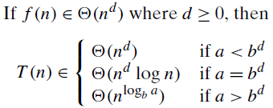
Divide and Conquer, Contd.
The Master Theorem
If T(n) is eventually nondecreasing (such as the vast majority of functions that we encounter in the analysis of algorithms)
and
then
Similar results hold for the O and Ω notations
Notes:
Remember that Theta implies Big O and Omega
provides approximate solution to a recursive equation

Slide 6
Divide and Conquer, Contd.
Examples
T(n) = 4T(n/2) + n ⇒ T(n) ∈? Answer: Θ(n^{log24})
T(n) = 4T(n/2) + n² ⇒ T(n) ∈? Answer: Θ(n² log n)
T(n) = 4T(n/2) + n³ ⇒ T(n) ∈? Answer: Θ(n³)

Slide 7
Divide and Conquer, Contd.
Examples
Sorting: Mergesort and quicksort
Binary search
Binary tree algorithms
Multiplication of large integers
Matrix multiplication: Strassen’s algorithm
Closest-pair and convex-hull problems

Slide 8
Example 1: Quicksort
Quicksort: is a divide and conquer sorting algorithm that works by selecting a pivot element from the array and partitioning the other elements into two sub-arrays, according to whether they are smaller or larger than the pivot.
Explanation of the algorithm
Choose Pivot: Select an element as the pivot
Partition: Rearrange the array such that elements smaller than the pivot are on the left, and elements larger are on the right
Recursively Sort: Recursively apply QuickSort to the left sub-arrays
Recursively Sort: Recursively apply QuickSort to the Right sub-arrays
Base Case: Stop when the sub-array has 0 or 1 element.

Slide 9
Example 1: Quicksort, Contd.
Example: Sort the following list [45, 68, 90, 29, 34, 89,17]
Step 1: First Partitioning: (Pivot = 17): Partition around 17 [17,45, 68, 90, 29, 34, 89] Left Sub-array: Empty (no elements <17) Right Sub-array: [45, 68, 90, 29, 34, 89] | [17, 45, 68, 90, 29, 34, 89] [45, 68, 29, 34, 89, 90] [29, 34, 45, 68] [45, 68] Final Sorted Array: [17, 29, 34, 45, 68, 89, 90]
Step 2: Recursively Apply QuickSort on Right Sub-array: [45, 68, 90, 29, 34, 89] (Pivot = 89): Partition around 89 [45, 68, 29, 34, 89, 90] Left Sub-array: [45, 68, 29, 34] Right Sub-array: [90] (already sorted).
Recursively Apply QuickSort on Left Sub-array [45, 68, 29, 34] (Pivot = 34): Partition around 34: [29, 34, 45, 68] Left Sub-array: [29] (already sorted) Right Sub-array: [45, 68]
Recursively Apply QuickSort on [45, 68] (Pivot = 68): Partition around 68: [45, 68] Left Sub-array: [45] (already sorted) Right Sub-array: Empty

Slide 10
Example 1: Quicksort, Contd.
ALGORITHM QuickSort(A[0..n-1])
if n > 1 then
pivot ← Partition(A, 0, n-1)
QuickSort(A[0..pivot-1]) // Left sub-array
QuickSort(A[pivot+1..n-1]) // Right sub-array
FUNCTION Partition(A, low, high)
pivot ← A[high] // Select last element as pivot
i ← low - 1
for j ← low to high - 1 do
if A[j] < pivot then
i ← i + 1
swap A[i] and A[j]
swap A[i+1] and A[high] // Move pivot to its correct position
return i + 1 // Return pivot index
Example:
[45, 68, 90, 29, 34, 89] 89 is Pivot
[45, 68, 90, 29, 34, 89]
[45, 68, 90, 29, 34, 89]
[45, 68, 90, 29, 34, 89]
[45, 68, 29, 90, 34, 89]
[45, 68, 29, 34, 90, 89]
[45, 68, 29, 34, 89, 90]

Slide 11
Example 1: Quicksort, Contd.
Analysis of the algorithm (Best Case)
Divide the array into two sub-arrays (each of size n/2) in the best case.
Perform O(n) work to partition the array (comparing elements around the pivot)
T(n) = 2T(n/2) + f(n), where f(n) ∈ Θ(n)
Applying the Master theorem (with a = 2, b = 2, d = 1)
T(n) ∈ Θ(n log n)
So, the time efficiency is in Θ(n log n)
Notes:
Assuming as usual that n is a power of 2, we have the following recurrence for the running time of the algorithm

Slide 12
Example 1: Quicksort, Contd.
Analysis of the algorithm (Worst Case)
If we always select the first element, last element, or a bad pivot (e.g., the smallest or largest element) as the pivot, the algorithm may partition the array poorly leading to unbalanced partitions, such that one sub-array contains all elements except the pivot, and the other sub-array is empty or nearly empty.
The recurrence for QuickSort in the worst case is: T(n) = T(n-1) + n, T(1)=0
Where:
T(n−1) is the time taken to sort the sub-array of size n−1
n is the time spent on partitioning the array around the pivot
Solving the recurrence for T(n) by using backward substitution
So, the time efficiency is in Θ(n)
Notes:
Assuming as usual that n is a power of 2, we have the following recurrence for the running time of the algorithm

Slide 13

Example 1: Binary Search
Binary search is a remarkably efficient algorithm for searching in a sorted array
Explanation of the algorithm
Start with a left pointer l and a right pointer r at the beginning and end of the array
As long as the left pointer l does not cross the right pointer r, check the middle element between the two pointers
If it is the key, return its index
else, if the key is smaller, move r to the end of the LHS array portion
else, if the key is larger, move l to the beginning of the RHS array portion
If no key is found when the left pointer l crosses the right pointer r, return -1

Slide 14
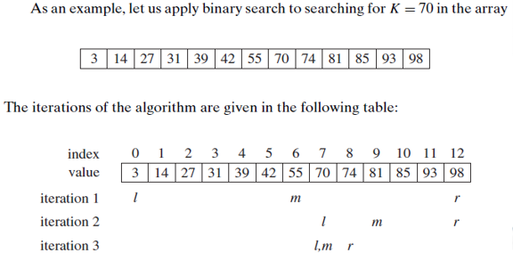
Example 1: Binary Search, Contd.

Slide 15
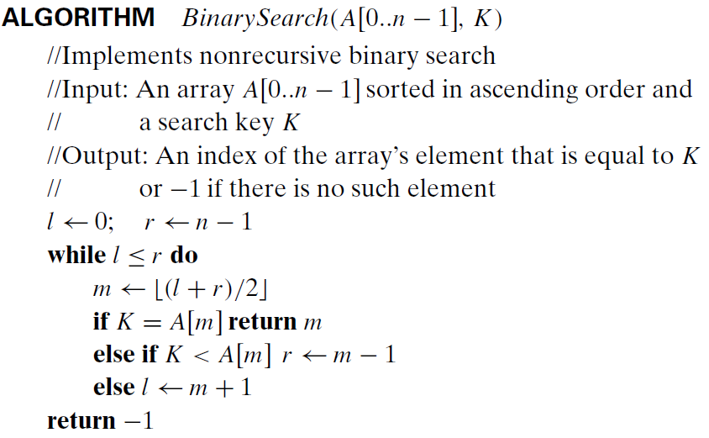
Example 1: Binary Search, Contd.
The algorithm
a recursive algorithm is possible
two pointers at the leftmost and rightmost elements of the array
as long as the left pointer does not cross the right pointer
If the middle element is the key, return its index
If the key is smaller, consider the left array portion
If the key is larger, consider the right array portion
when no key if found when the left pointer crosses the right pointer

Slide 16

Example 1: Binary Search, Contd.
Analysis of the algorithm
The worst-case include all input arrays that do not contain a given search key, as well as some successful searches
The number of key comparisons in the worst-case
For n=2^k, and Cworst(1)=1
It can be tweaked to get solution valid for arbitrary integer n
It implies that the worst-case time efficiency is in Θ(log n)
It will take no more than comparisons to do it for any sorted array of size one million!
one comparison
Refer to solution of recurrence of counting binary digits in Chapter one by backward substitution, but using this different initial condition in the last step (slide#41)
Notes:
O(log n) in general

Slide 17
Example 1: Binary Search, Contd.
Notes on the algorithm
Pros: Optimal for searching a sorted array
Cons (limitation): must be a sorted array (not linked list)
Bad (degenerate) example of divide-and-conquer because only one of the sub-instances is solved
Has a continuous counterpart called bisection method for solving equations in one unknown f(x) = 0 (see Sec. 12.4)

Slide 18
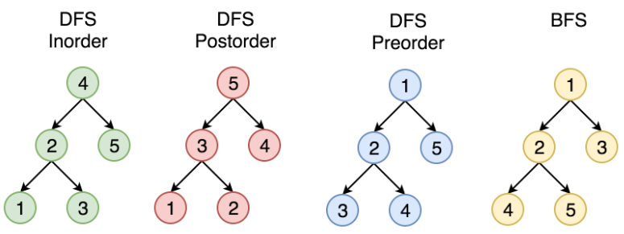
Example 2: Binary Tree Algorithms
Binary tree can be traversed in different ways
start from the leaves start from the root
https://zhang-xiao-mu.blog/2019/01/20/tree-traversal-preorder-postorder/

Slide 19
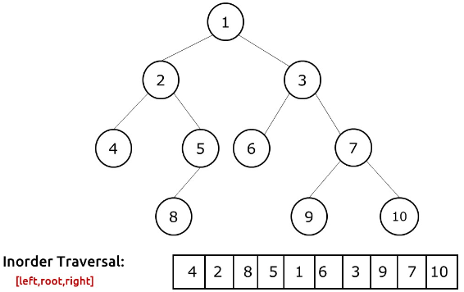
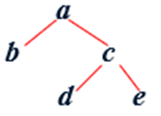
Example 2: Binary Tree Algorithms, Contd.
Binary tree is a divide-and-conquer ready structure (many binary tree problems can be solved by applying the divide-and-conquer technique)
In the inorder traversal, the root is visited after visiting its left subtree but before visiting the right subtree (left subtree, root, right subtree)
b,a,d,c,e
https://takeuforward.org/data-structure/inorder-traversal-of-binary-tree/

Slide 20
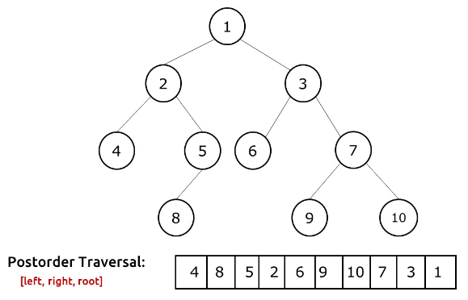
Example 2: Binary Tree Algorithms, Contd.
In the postorder traversal, the root is visited after visiting the left and then right subtrees (left subtree, right subtree, root)
b,d,e,c,a
https://takeuforward.org/data-structure/post-order-traversal-of-binary-tree/

Slide 21
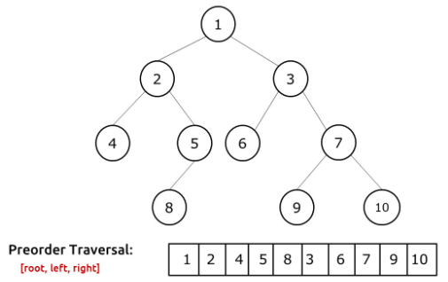
Example 2: Binary Tree Algorithms, Contd.
In the preorder traversal, the root is visited before visiting the left and then right subtrees (root, left subtree, right subtree)
a,b,c,d,e
https://takeuforward.org/data-structure/preorder-traversal-of-binary-tree/

Slide 22
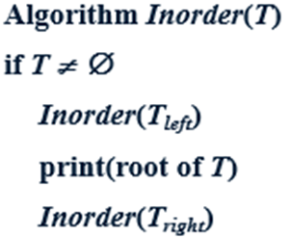

Example 2: Binary Tree Algorithms, Contd.
The
Analysis of the algorithm
Time efficiency
Each node is visited/printed once
Notes:
the time complexity of M(n)=2M(n/2)+1 is O(n)

Slide 23
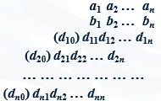
Example 3: Multiplication of Large Integers
Consider the problem of multiplying two (large) n-digit integers
A = 12345678901357986429 B = 87654321284820912836
In the conventional grade-school algorithm, ..
each of the n digits of the first number is multiplied by each of the n digits of the second number for the total of n² digit multiplications
Analysis of the algorithm
Time efficiency is in Θ(n²) single digit multiplications
Notes:
Some applications, notably modern cryptography, require manipulation of integers that are over 100 decimal digits long. Since such integers are too long to fit in
a single word of a modern computer, they require special treatment. This practical need seeks algorithms for efficient manipulation of large integers.

Slide 24
Example 3: Multiplication of Large Integers, Contd.
In a better algorithm, consider the problem of multiplying two n-digit integers represented by arrays of their digits, e.g., A = 2135 and B = 4014
A = 21·10² + 35, B = 40·10² + 14
A * B = (21·10² + 35) * (40·10² + 14)
= (21 * 40)·10⁴ + (21 * 14 + 35 * 40)·10² + 35 * 14
In general, if A = A₁A₂ and B = B₁B₂ (where A and B are n-digit numbers and A₁, A₂, B₁, B₂ are n/2-digit numbers),
A * B = A₁* B₁·10^{n} + (A₁ * B₂ + A₂ * B₁)·10^{n/2} + A₂ * B₂
divide each into two

Slide 25
Example 3: Multiplication of Large Integers, Contd.
Analysis of the algorithm
Since multiplication of n-digit numbers requires four multiplications of n/2-digit numbers, recurrence for the number of multiplications M(n)
M(n) = 4M(n/2), M(1) = 1
Solution:
It can be solved using the backward substitution method studied in Chapter 1 (Homework)
Or by using the Master Theorem:
a = 4, b = 2, d = 0
a > b^{d}, Therefore, M(n) ∈ Θ(n^{log} _{b} a ) = Θ (n^{log}₂ 4) ≈ Θ ( n² )

Slide 26
Example 3: Multiplication of Large Integers, Contd.
In an even better algorithm, consider the problem of multiplying two 2-digit integers represented by arrays of their digits, e.g., a = 23 and b = 14
a = 2·10¹ + 3, b = 1·10¹ + 4
a * b = (2·10¹ + 3) * (1·10¹ + 4)
= (2 * 1)·10² + (2 * 4 + 3 * 1)·10¹ + (3 * 4)
2 * 4 + 3 * 1 = (2 + 3) * (1 + 4) - 2 * 1 - 3 * 4 (subtract extra terms when attempting to convert summation of products to product of summations)
2 * 4 + 3 * 1 = (2 + 3) * (1 + 4) – (2 * 1 + 3 * 4)
decrease of the number of multiplications from 4 to 3 (at the expense of 3 extra add/sub)

Slide 27
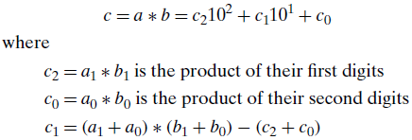
Example 3: Multiplication of Large Integers, Contd.
23 * 14 = (2 * 1)·10² + (2 * 4 + 3 * 1)·10¹ + (3 * 4)
where 2 * 4 + 3 * 1 = (2 + 3) * (1 + 4) – (2 * 1 + 3 * 4)
In general, for any pair of two-digit integers a = a₁a₀ and b = b₁b₀, their product c can be computed as follows

Slide 28
Example 3: Multiplication of Large Integers, Contd.
Consider the problem of multiplying two (large) n-digit integers represented by arrays of their digits, e.g., A = 2135 and B = 4014
A = 21·10² + 35, B = 40·10² + 14
A * B = (21·10² + 35) * (40·10² + 14)
= (21 * 40)·10⁴ + (21 * 14 + 35 * 40)·10² + (35 * 14)
21 * 14 + 35 * 40 = (21 + 35) * (40 + 14) - 21 * 40 - 35 * 14 (subtract extra terms when attempting to convert summation of products to product of summations)
21 * 14 + 35 * 40 = (21 + 35) * (40 + 14) – (21 * 40 + 35 * 14)
decrease of the number of multiplications from 4 to 3 (at the expense of 3 extra add/sub)

Slide 29
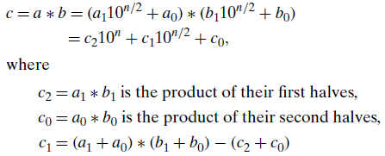
Example 3: Multiplication of Large Integers, Contd.
2135 * 4014 = (21 * 40)·10⁴ + (21 * 14 + 35 * 40)·10² + (35 * 14)
where 21 * 14 + 35 * 40 = (21 + 35) * (40 + 14) – (21 * 40 + 35 * 14)
In general, for any pair of n-digit integers a = a₁a₀ and b = b₁b₀ where n is a positive integer, a = a₁10^{n/2} + a₀, and b =b₁10^{n/2} + b₀, their product c can be computed as follows

Slide 30
Example 3: Multiplication of Large Integers, Contd.
In an even better algorithm, consider the same problem of multiplying A = 2135 and B = 4014
2135 * 4014 = (21 * 40)·10⁴ + (21 * 14 + 35 * 40)·10² + (35 * 14)
where 21 * 14 + 35 * 40 = (21 + 35) * (40 + 14) – (21 * 40 + 35 * 14)
and
21 * 40 = (2 * 4)·10² + (2 * 0 + 1 * 4)·10¹ + (1 * 0)
where 2 * 0 + 1 * 4 = (2 + 1) * (4 + 0) – (2 * 4 + 1 * 0)
and
35 * 14 = (3 * 1)·10² + (3 * 4 + 5 * 1)·10¹ + (5 * 4)
where 3 * 4 + 5 * 1 = (3 + 5) * (1 + 4) – (3 * 1 + 5 * 4)
decrease of the number of multiplications from 16 (grade school algorithm) to 9

Slide 31
Example 3: Multiplication of Large Integers, Contd.
Analysis of the algorithm
Since multiplication of n-digit numbers requires three multiplications of n/2-digit numbers, recurrence for the number of multiplications M(n) M(n) = 3M(n/2), M(1) = 1
Solution: It can be solved using the backward substitution method studied in Chapter 1(Homework)
Or by using the Master Theorem:
a = 3, b = 2, d = 0
a > b^{d}, Therefore,
M(n) ∈ Θ(n^{log b a} ) = Θ (n^{log2 3}) ≈ Θ ( n^{1.585} )
What if we count both multiplications and additions?

